Slide 1

KIET GROUP OF INSTITUTIONS Department of Computer Applications

Slide 2
Office COLLABRATOR
MENTOR – DR. NARESH CHANDRA
TEAM MEMBERS – SHIVANGI SAXENA
AYUSHI SRIVASTAVA
HARSHIKA SRIVASTAVA

Slide 3

INTRODUCTION
There will be 2 types of user groups: Employee and Admin.
Employee group can be composed of roles like Software Engineer, Lead Engineer, etc.
Admin can also add employee and its details.
We will Develop a UI portal and backend for the same using PHP, MYSQL for connectivity.
Both Employee and Administrator can do different work in this.

Slide 4





TECHNOLOGY USED

Slide 5
Functions of Functions of ADMIN EMPLOYEE
Add an employee with its name, email, password, etc.
Update and employee details
Delete an employee details
Login into account from credentials created by admin.
Edit his/her personal details
Search employees of his/her organization

Slide 6
SOFTWARE HARRDWARE REQUIREMENTS REQUIREMENTS
Windows Operating System
Google Chrome
Xamp Server
Desktop / PC

Slide 7
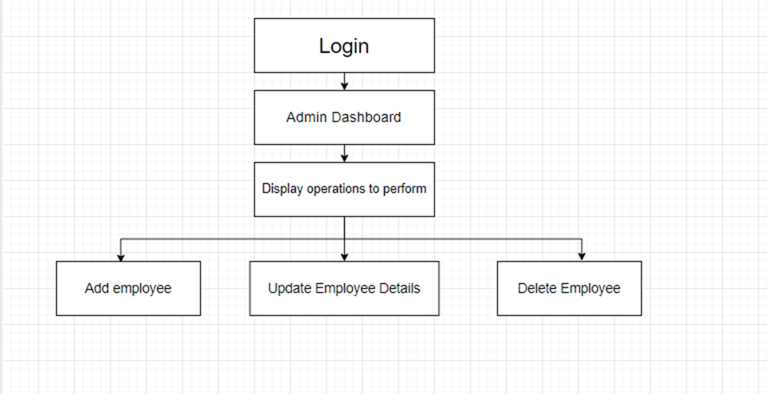
ADMIN Operations Flowchart

Slide 8
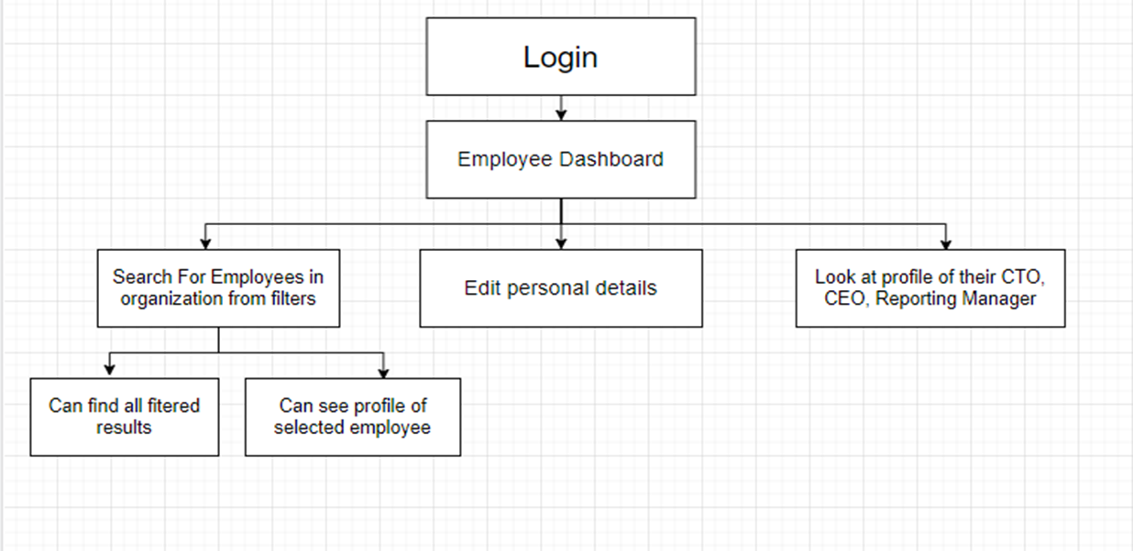
Employee Operations Flowchart

Slide 9
THANK YOU

